Slide 1
Processing Devices
Mirza Farhan Bin Tarek
Lecturer, Dept. of Computer Science and Engineering,
BRAC University,
Dhaka, Bangladesh

Slide 2
Contents
Microcontrollers
Arduino Uno Development Board
SoCs and Single Board Computers
Microprocessors with examples
Microprocessors vs Microcontrollers
PLA (Programmable Logic Array)
PLC (Programmable Logic Controller)
FPGA (Field Programmable Gate Array)

Slide 3
Microcontrollers
Microcontrollers are used is embedded systems for performing specific tasks such as receiving remote signals, operating ATM machines, controlling air conditioner devices etc.
In microcontrollers, memory devices such as RAM, ROM, CPU etc. are all embedded into a single chip. They can directly interface with switches, servo motors etc.
Speed: low speed compared to microprocessors. (for example 16 MHz)
Cost: low. Used for cost efficient designing and in research and academic projects.
Packaging: is very high. We can embed it in small devices easily.
Complexity: Programming is difficult as we need separate burner softwares. But development boards like Arduino UNO can make the process easier. Can be used for R&D
Application: In industrial sector, in IoT, in R&D,
Power consumption: very low

Slide 4
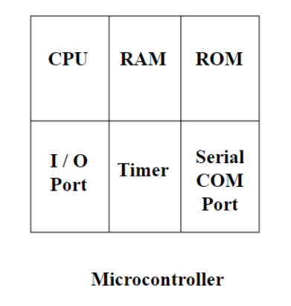
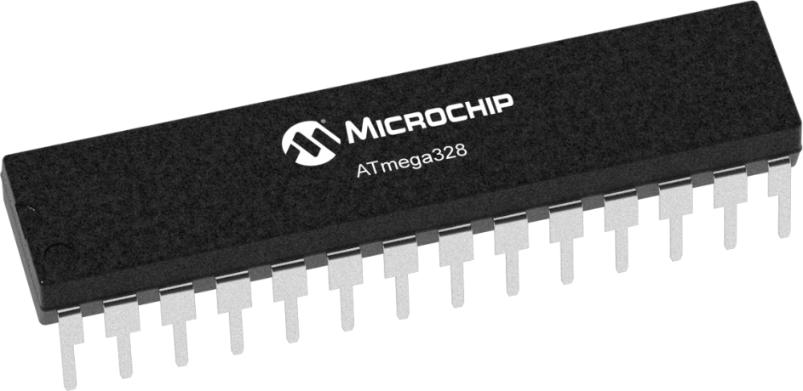
Microcontrollers (Contd.)
ATmega 328 Microcontroller

Slide 5
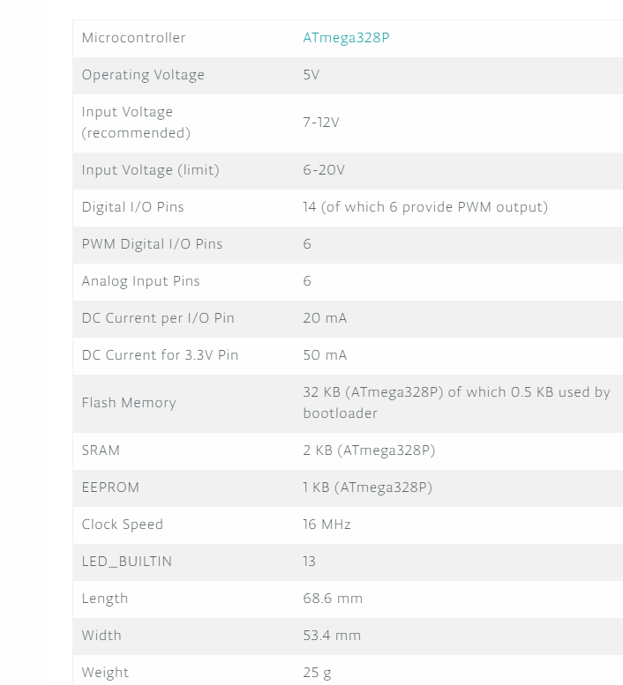
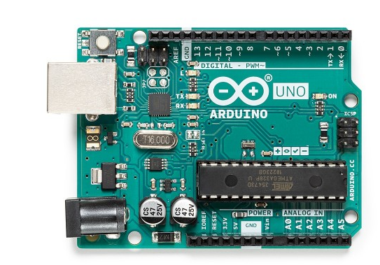
Arduino Uno Specifications

Slide 6
Arduino Uno (Contd.)
The Arduino Uno is an open-source microcontroller board based on the microchip ATmega328P microcontroller
The board is equipped with sets of digital and analog input/output (I/O) pins that may be interfaced to various expansion boards (shields) and other circuits.
It is mainly used for academic projects and research. After testing a program with Arduino Uno, we can deploy the program in actual case
Not suitable for developing complex projects.

Slide 7
General pin functions of Arduino Uno
LED: There is a built-in LED driven by digital pin 13. When the pin is high value, the LED is on, when the pin is low, it is off.
VIN: The input voltage to the Arduino board when it is using an external power source (as opposed to 5 volts from the USB connection or other regulated power source). You can supply voltage through this pin, or, if supplying voltage via the power jack, access it through this pin.
5V: This pin outputs a regulated 5V from the regulator on the board. The board can be supplied with power either from the DC power jack (7 - 20V), the USB connector (5V), or the VIN pin of the board (7-20V). Supplying voltage via the 5V or 3.3V pins bypasses the regulator, and can damage the board.
3V3: A 3.3 volt supply generated by the on-board regulator. Maximum current draw is 50 mA.
GND: Ground pins.
IOREF: This pin on the Arduino board provides the voltage reference with which the microcontroller operates. A properly configured shield can read the IOREF pin voltage and select the appropriate power source, or enable voltage translators on the outputs to work with the 5V or 3.3V.
Reset: Typically used to add a reset button to shields that block the one on the board.^{[7]}

Slide 8
Special pin functions
Each of the 14 digital pins and 6 analog pins on the Uno can be used as an input or output, under software control (using pinMode(), digitalWrite(), and digitalRead() functions). They operate at 5 volts.
The Uno has 6 analog inputs, labeled A0 through A5; each provides 10 bits of resolution (i.e. 1024 different values). By default, they measure from ground to 5 volts, though it is possible to change the upper end of the range using the AREF pin and the analogReference() function.
In addition, some pins have specialized functions:
Serial / UART: pins 0 (RX) and 1 (TX). Used to receive (RX) and transmit (TX) TTL serial data. These pins are connected to the corresponding pins of the ATmega8U2 USB-to-TTL serial chip.
External interrupts: pins 2 and 3. These pins can be configured to trigger an interrupt on a low value, a rising or falling edge, or a change in value.
PWM (pulse-width modulation): pins 3, 5, 6, 9, 10, and 11. Can provide 8-bit PWM output with the analogWrite() function.
SPI (Serial Peripheral Interface): pins 10 (SS), 11 (MOSI), 12 (MISO), and 13 (SCK). These pins support SPI communication using the SPI library.
Notes:
UART stands for Universal Asynchronous Receiver/Transmitter. It's not a communication protocol like SPI and I2C, but a physical circuit in a microcontroller, or a stand-alone IC. A UART's main purpose is to transmit and receive serial data.

Slide 9
System on a Chip (SoC)
A system on a chip is an integrated circuit that integrates all or most components of a computer or other electronic system.
These components almost always include a central processing unit, memory, input/output ports and secondary storage – all on a single substrate or microchip, the size of a coin.
These chip has better and more powerful processing capabilities than traditional microcontroller.
They are also small enough to implement in embedded devices. Can also be interfaced with keyboards, mouses, displays to function as an actual PC.
For example, Raspberry Pi, Nvidia Jetson they implement SoCs in the development board.

Slide 10
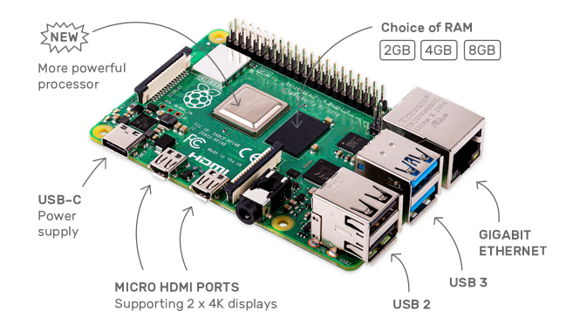
SoC Example-1 (Broadcom BCM2711)
Raspberry Pi 4 module B is a development board + computing device that contains the Cortext-A72 SoC. We can call it a single board computer
Broadcom BCM2711, Quad core Cortex-A72 (ARM v8) 64-bit SoC @ 1.5GHz
2GB, 4GB or 8GB LPDDR4-3200 SDRAM (depending on model)
2.4 GHz and 5.0 GHz IEEE 802.11ac wireless, Bluetooth 5.0, BLE
Gigabit Ethernet
2 USB 3.0 ports; 2 USB 2.0 ports.
Raspberry Pi standard 40 pin GPIO header (fully backwards compatible with previous boards)
2 × micro-HDMI ports (up to 4kp60 supported)
2-lane MIPI DSI display port
2-lane MIPI CSI camera port
4-pole stereo audio and composite video port
Raspberry Pi 4 Module B

Slide 11
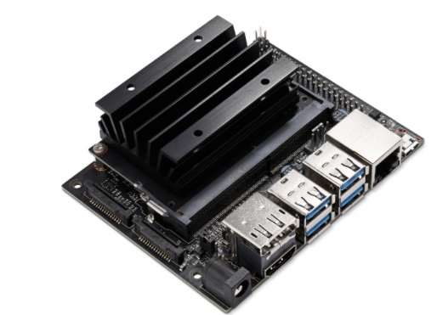
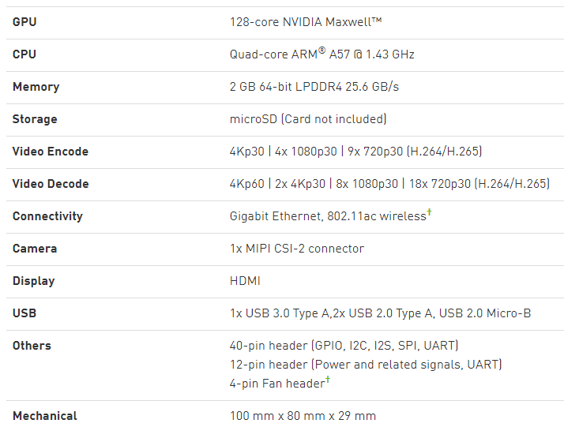
SoC Example-2 (Nvidia Tegra)
Nvidia Jetson Nano development board
It implements Tegra SoCs which has Maxwell architecture GPU and ARM architecture CPU.
Jetson boards are focused on Machine learning applications.

Slide 12
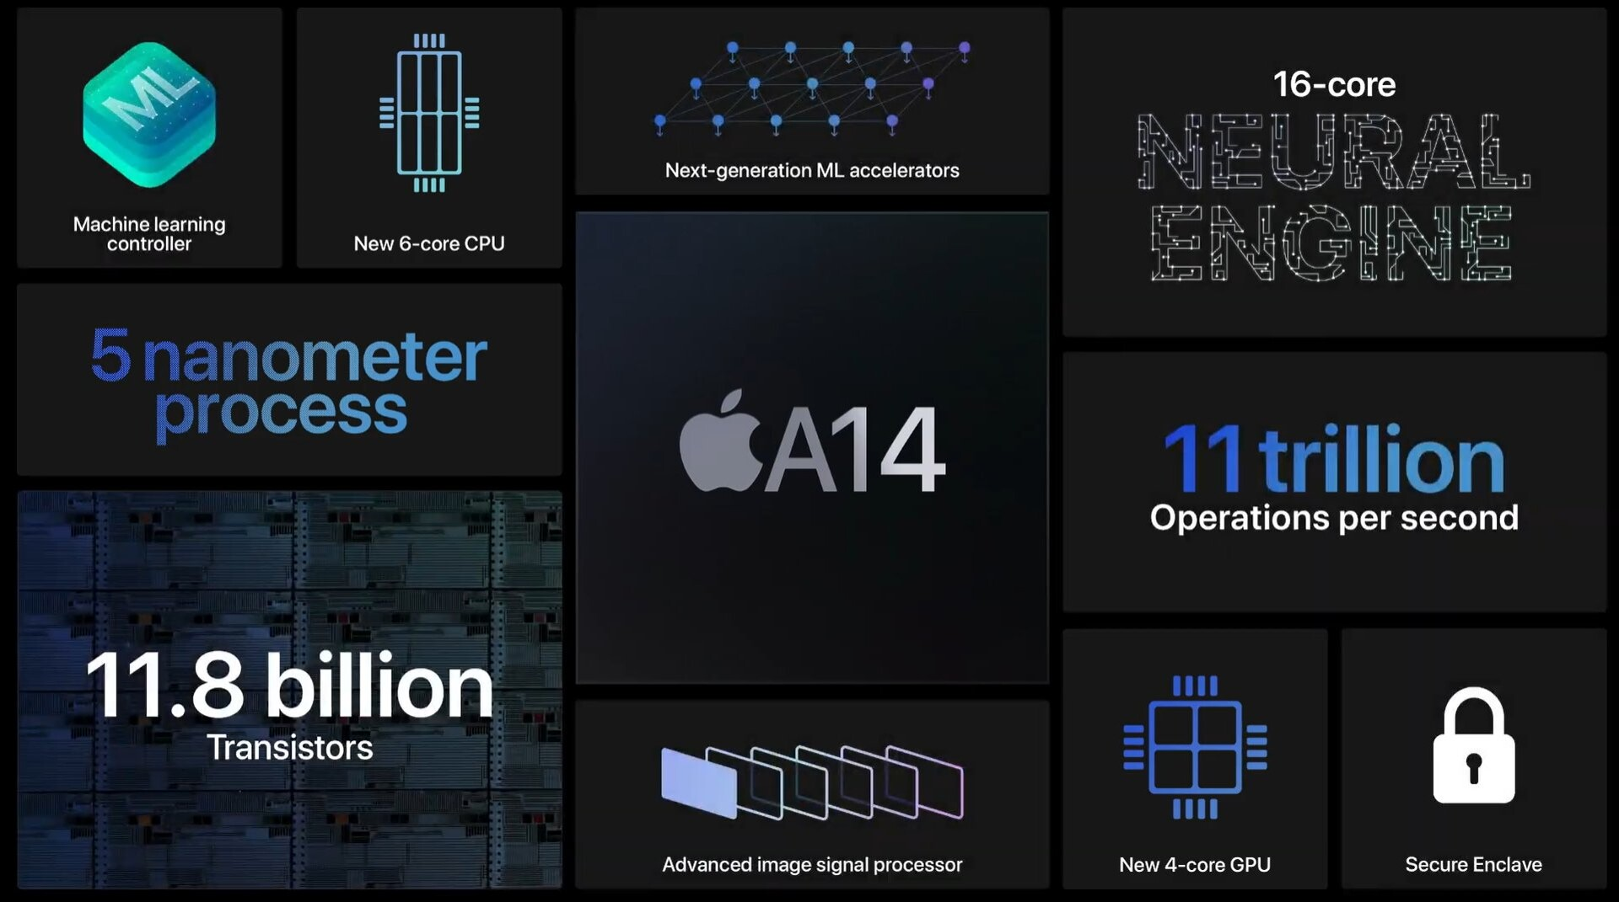
SoC Example-3 (Apple A14 Bionic)
64-bit SoC supporting the ARMv8 architecture
Dedicate neural network hardware, called 16-core Neural Engine
A14 CPU includes 2nd gen machine learning matrix scalar multiplication accelerators.
Also includes Apple designed 4-core GPU

Slide 13
Microprocessors
Microprocessors are used for more complex tasks ( e.g. video editing, gaming etc.) compared to microcontrollers.
RAM, ROM, I/O ports are all external to the microprocessors.
Speed: higher speed compared to microprocessors. (AMD Ryzen 5 3600 has 3.6 GHz clock speed)
Cost: High
Complexity: Very complex design and programming is also complex.
Power consumption: higher than microcontrollers.

Slide 14
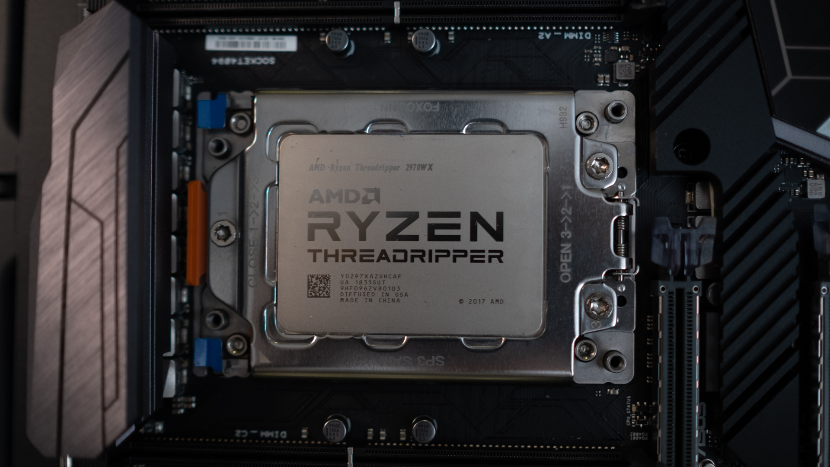
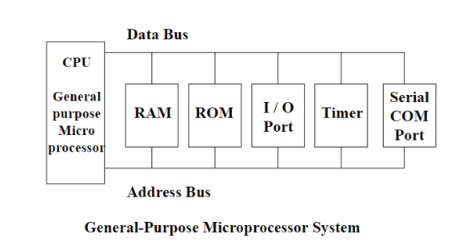
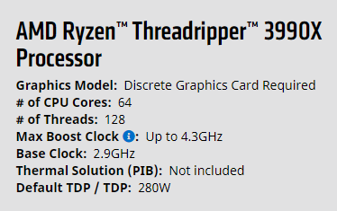
Microprocessors ( Contd.)

Slide 15
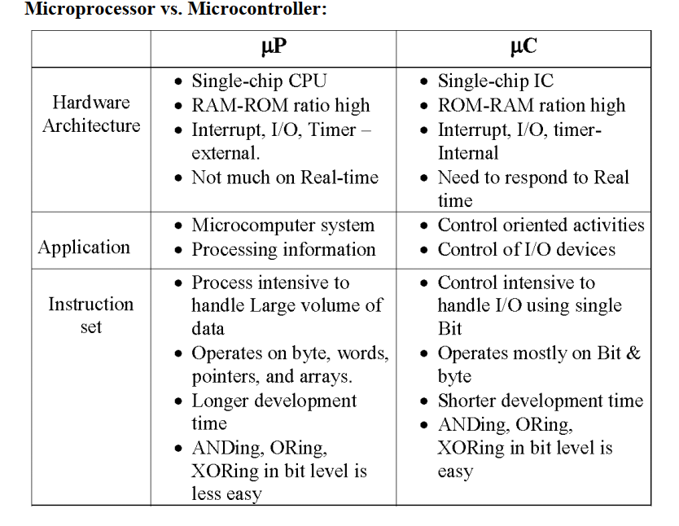
Microprocessors vs Microcontrollers

Slide 16
PLA (Programmable Logic Array)
It is based on the sum-of-products concept.
It is a general open circuit consisting of large number of AND gates and OR gates
Connection are determined according to the specification specified by the customer.
Creation process:
First, they translate your expressions into sum-of-products expressions. In general, with 3 input variables, there will be a maximum of 2³ = 8 terms in the sum-of-products for each variable for each output variable Yi
Then, they take an intact circuit which consists of two parts. The top part has a set of rows (wires) which carry variables A, A’, B, B’, etc. There are also a set of vertical wires that carry product terms.
If there are m input variables, then the columns are grouped into m-tuples. Each m tuple carries one variable. (Each product term has at most m variables.) The m-tuples (or less than m) are fed into AND gates i.e. to form the products you need
Below the AND gates, the products are appropriately OR-ed together to give the sums we want.

Slide 17
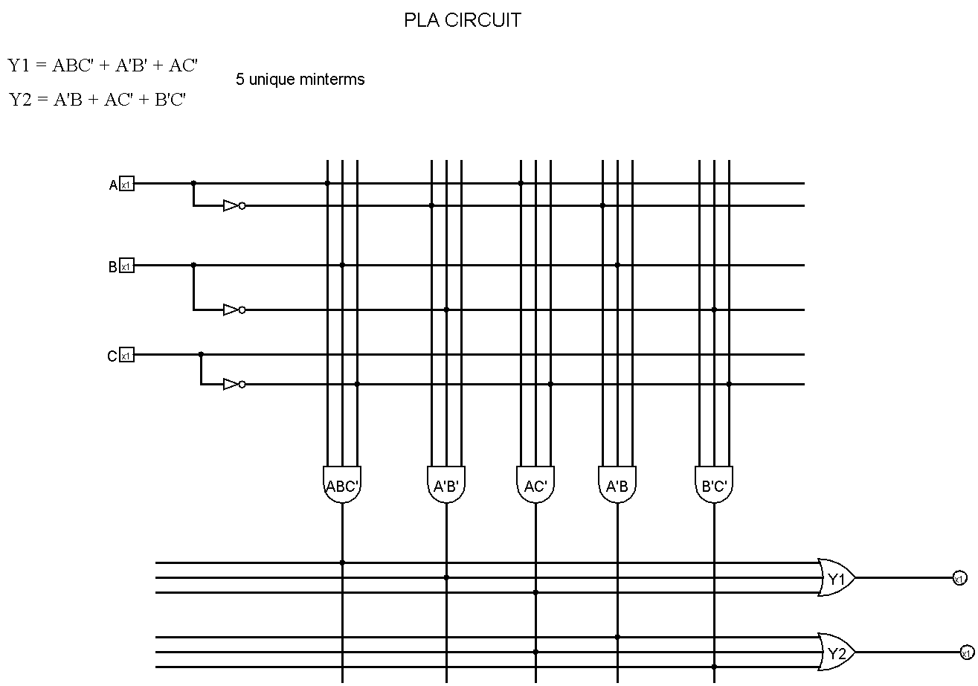
PLA (Programmable Logic Array) (Contd.)

Slide 18
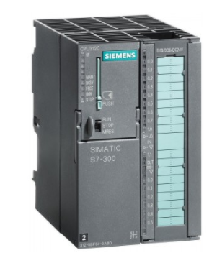
PLC (Programmable Logic Controller)
A PLC is an industrial microprocessor-based controller with programmable memory used to store program instructions and various functions. It consists of:
a processor unit (CPU) which interprets inputs, executes the control program stored in memory and sends output signals,
a power supply unit which converts AC voltage to DC,
a memory unit storing data from inputs and program to be executed by the processor,
an input and output interface, where the controller receives and sends data from/to external devices,
a communications interface to receive and transmit data on communication networks from/to remote PLCs.
PLCs require programming device which is used to develop and later download the created program into the memory of the controller.
Modern PLCs generally contain a real-time operating system, such as OS-9 or VxWorks.

Slide 19
PLC (Contd.)
Speed: low speed, heavy duty
Cost: Very high (Industrial)
Packaging: Not good compared to µC or µP.
Complexity: Programming is not complex, but program downloading is easier than µC but complex than µP
Application: heavy duty industrial usage e.g. car factories, metalworks factories
Power consumption: more than µC

Slide 20
FPGA (Field Programmable Gate Array)
It is an IC designed to be configured by the customer after manufacture.
The programming is performed using HDL or Hardware Description Language.
FPGAs contain an array of programmable logic blocks, and a hierarchy of "reconfigurable interconnects" that allow the blocks to be "wired together“
In most FPGAs, logic blocks also include memory elements, which may be simple flip-flops or more complete blocks of memory.
Many FPGAs can be reprogrammed to implement different logic functions, allowing flexible reconfigurable computing as performed in computer software.
FPGAs have a remarkable role in the embedded system development due to capability to start system software (SW) development simultaneously with hardware (HW), enable system performance simulations at a very early phase of the development, and allow various system partitioning (SW and HW) trials and iterations before final freezing of the system architecture.

Slide 21
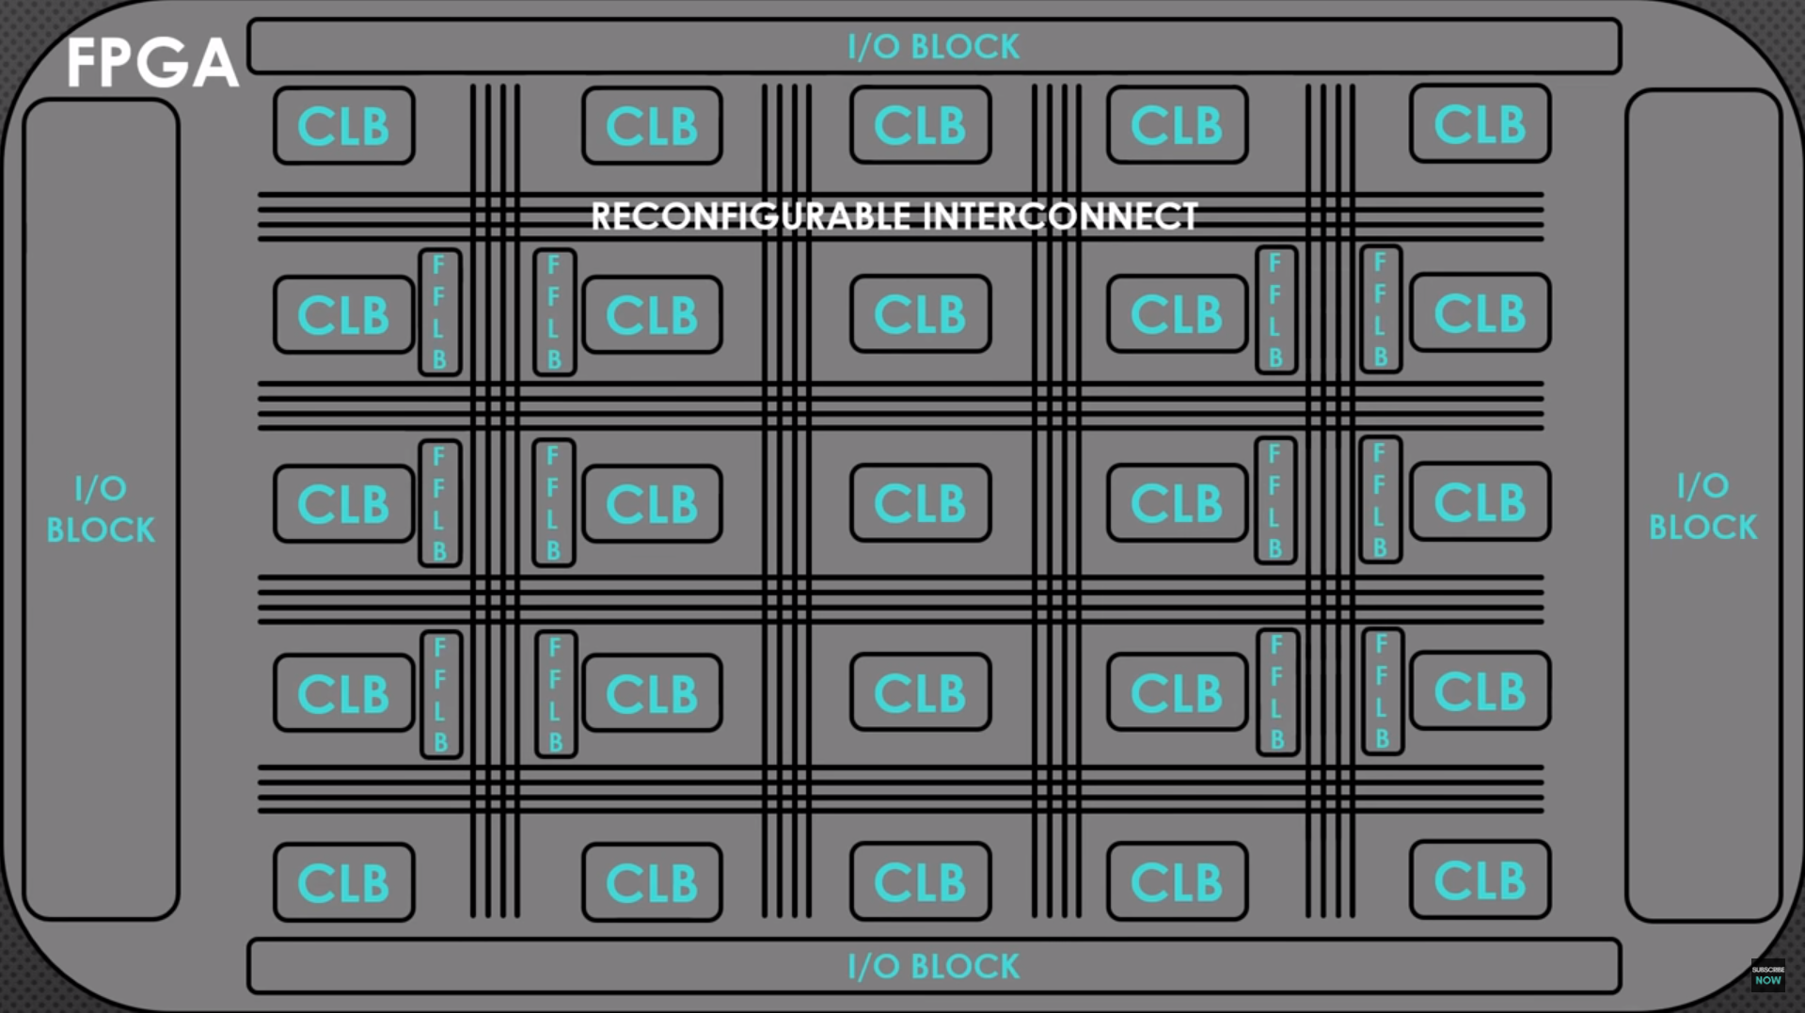
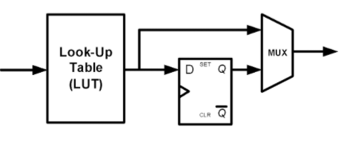
FPGA Internal Structure
CLB or Configurable logic blocks comprise of Lookup Tables, D flip flops, Mux, Full Adder. An n-bit LUT can encode any n-input Boolean function by storing the truth table of the function in the LUT. This is an efficient way of encoding Boolean logic functions, and LUTs with 4-6 bits of input are in fact the key component of modern FPGAs.
Interconnect wires connect the CLBs with each other
FFLB or Fixed-Function Logic Blocks, which contain multipliers etc.
I/O blocks are for inputting or outputting data.

Slide 22
Use of FPGA
Aerospace and defense: communication, avionics, missile system etc.
ANN: FPGAs can be used to implement ANN efficiently and can be reconfigured on the fly.
Audio: DAC, DSP, Speech recognition
Industrial: Industrial Imaging, Industrial Networking, Motor Control
Wired Communications: Optical Transport Networks, Network Processing, Connectivity Interfaces

Slide 23
Difference between PLC and FPGA
PLCs are industrial grade devices capable of taking 1000+ digital/analog input, process and output them.
How the sensor input will be processed to provide different outputs is programmable however it is typically used in a fixed system.
FPGAs are more robust in input/output processing. They can be programmed to perform arbitrary tasks. For example, an FPGA can be programmed to work as an MPEG decoder and the same FPGA can be programmed later to work as neural net processor. So unlike PLCs they are not programmed to perform fixed input/output operations.
FPGAs are programmed using hardware definition languages such as VHDL or Verilog

Slide 24
Resources
https://en.wikipedia.org/wiki/Field-programmable_gate_array
https://en.wikipedia.org/wiki/PLC
https://en.wikipedia.org/wiki/Programmable_logic_array
https://en.wikipedia.org/wiki/Microcontroller
https://en.wikipedia.org/wiki/Microprocessor
https://en.wikipedia.org/wiki/Arduino_Uno
https://www.notebookcheck.net/Apple-A14-Bionic-Processor-Benchmarks-and-Specs.494578.0.html
https://developer.nvidia.com/embedded/jetson-nano-2gb-developer-kit
https://www.raspberrypi.org/products/raspberry-pi-4-model-b/specifications/?resellerType=home

